Slide 1
Please complete at least one of these per day. Pleas email your work to year6@woodstone.leics.sch.uk
Find the total of the fractions.
Give your answer in its simplest form.
$\frac{5}{9}$ $+$ $\frac{1}{9}= \frac{5}{9}$ $+$ $\frac{3}{9}$ $=$ $\frac{5}{9}$ $+$ $\frac{7}{9}$ $=$
Do all the answers need simplifying?
Explain why.

Slide 2
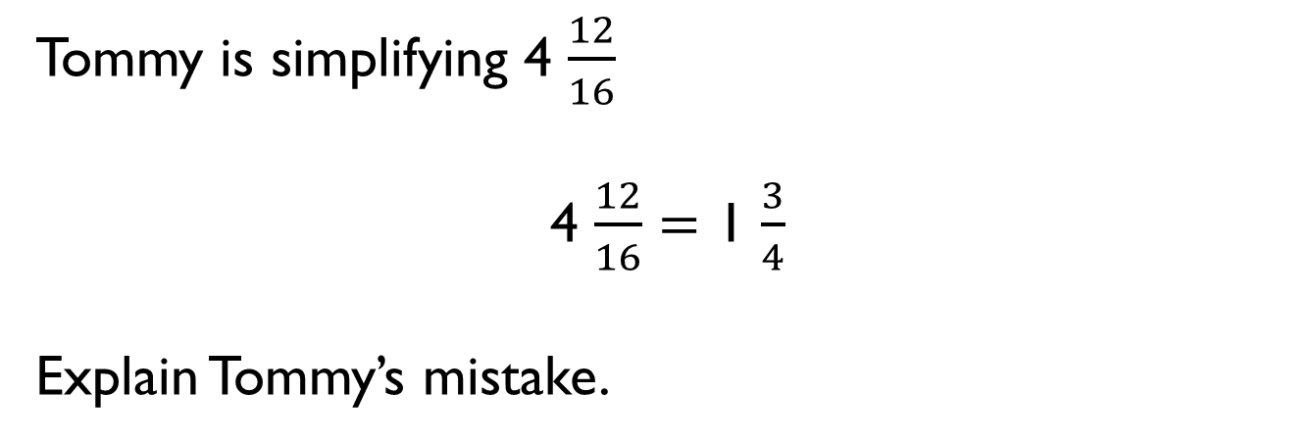
Tommy is simplifying 4 $\frac{12}{16}$
4 $\frac{12}{16}$ $=$ 1 $\frac{3}{4}$
Explain Tommy’s mistake.

Slide 3
Sort the fractions into the table.
Can you see any patterns between the numbers in each column?
What is the relationship between the numerators and denominators?
Can you add three more fractions to each column?
When a fraction is equivalent to _____,
the numerator is _______ the denominator.
Simplifies to $\frac{1}{2}$ | Simplifies to $\frac{1}{3}$ | Simplifies to $\frac{1}{4}$
$\frac{5}{15}$
$\frac{2}{4}$
$\frac{4}{16}$
$\frac{8}{16}$
$\frac{2}{8}$
$\frac{3}{9}$
$\frac{6}{12}$
$\frac{5}{10}$

Slide 4
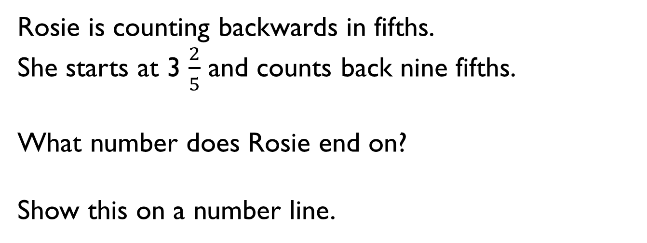
Rosie is counting backwards in fifths.
She starts at 3 $\frac{2}{5}$ and counts back nine fifths.
What number does Rosie end on?
Show this on a number line.

Slide 5
Plot the sequences on a number line.
3 $\frac{1}{2}$ , 4, 4 $\frac{1}{2}$, 5, 5 $\frac{1}{2},$ 6
$\frac{13}{4}$ , $\frac{15}{4}$, $\frac{17}{4}$, $\frac{19}{4}$ , $\frac{21}{4}$, $\frac{23}{4}$
5 $\frac{5}{8}$, 5 $\frac{1}{8}$ , 4 $\frac{5}{8}$ , 4 $\frac{1}{8}$ , 3 $\frac{5}{8}$ , 3 $\frac{1}{8}$
3 $\frac{1}{8}$ , 3 $\frac{3}{8}$, 3$\frac{5}{8}$ , 3 $\frac{7}{8}$ , 4 $\frac{1}{8}$ , 4 $\frac{3}{8}$
Which sequence is the odd one out? Explain why.
Can you think of a reason why each of the sequences could be the odd one out?

Slide 6
Use the digit cards to complete the statements.
Find three examples of ways you could complete the statement.
Can one of your ways include an improper fraction?
5
6
3
4
6
6
$$>$$
$$<$$
4
4
$$<$$

Slide 7
Teddy is comparing $\frac{3}{8}$ and $\frac{5}{12}$
Is Teddy correct?
Explain why.
To find the lowest common multiple, I will multiply 8 and 12 together.
8 $×$ 12 $=$ 96
I will use a common denominator of 96

Slide 8
Mo is comparing the fractions $\frac{3}{7}$ and $\frac{6}{11}$
He wants to find a common denominator.
Explain whether you think this is the most effective strategy.

Slide 9


Two different pieces of wood have had a fraction chopped off.
Here are the pieces now, with the fraction that is left.
Which piece of wood was the longest to begin with?
Explain your answer.
Can you explain your method?
$$\frac{5}{6}$$
$$\frac{3}{4}$$

Slide 10
Use the same digit in both boxes to complete the calculation.
Is there more than one way to do it?
1
9
$$+$$
$$=$$
20
20

